Slide 1
Job Matcher v1
A geek’s way of finding a dream job

Slide 2
My story
Willing to relocation in the USA: I don’t know much about the location. I have to spend extra time research the location of a job.
Decided to change industry: I have a broad interest and an open mind. But I have limited experience in other industries from my past. Say, I don’t know what’s the best match,
I want to create a comprehensive way of search for a dream job. Take care of the all those factors: location,

Slide 3
Date science job in different industry
Finance
Insurance
Sport
Agriculture
Manufacturing
Retailer
Healthcare
Music, entertainment

Slide 4
The idea
? Questionaire
What is in my mind?
Date base:
22000 jobs from web scrap, available in Kaggle.

Slide 5
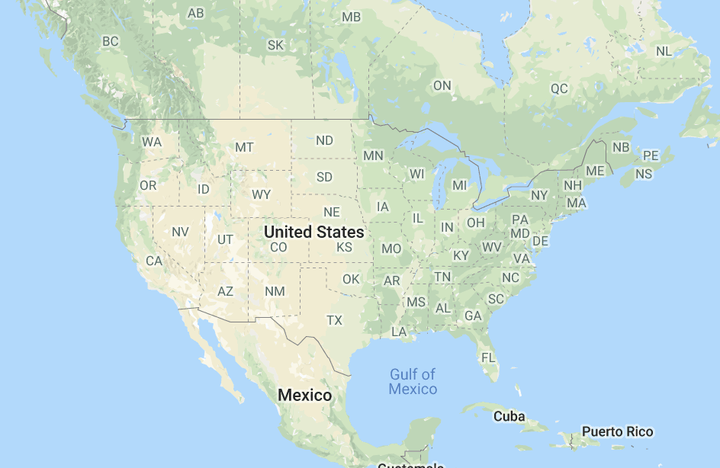
Location index:
Things to consider:
relocation? Calculate the distance between zip code.
Population? Load the population density map.
Many other factors for future study.

Slide 6
Industry index

